Slide 1

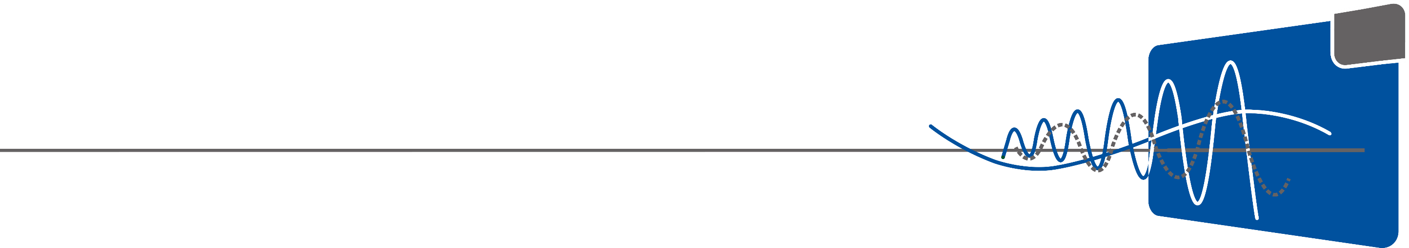

Hyperparameter Optimization of a U-Net Trained for
Fat Detection in Liver Sections
Bilgecan Cihan
[ M.Sc. Computational Mechanics of Materials and Structures ]
[ University of Stuttgart ]

Slide 2
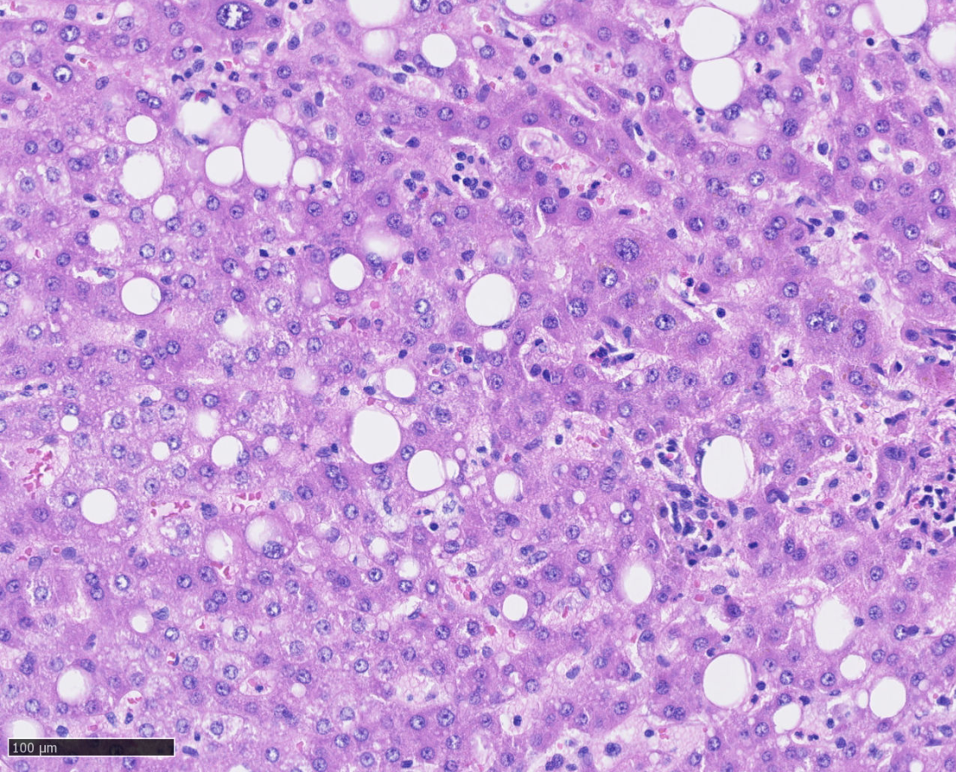
Motivation of the Study
Fat detection in liver sections with the help of an artificial neural network
Semantic Segmentation problem with U-Net architecture
Hyperparameter optimization to increase validation scores
Visualization of the results

Slide 3
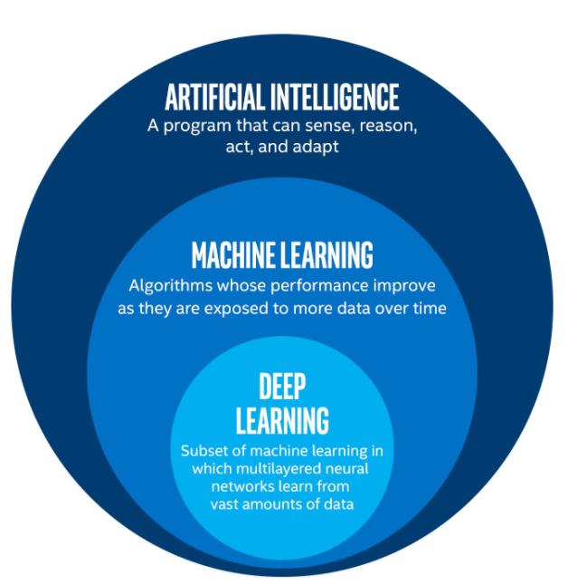
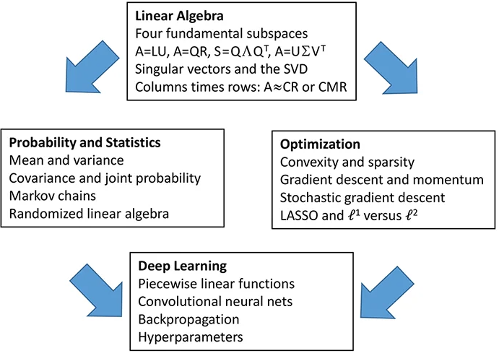
What is an Artificial Neural Network ?
The AI Scheme (Artificial Intelligence | Machine Learning | Deep Learning | Argility, n.d.)
Matrix Methods in Data Analysis, Signal Processing, and Machine Learning. Spring 2018

Slide 4
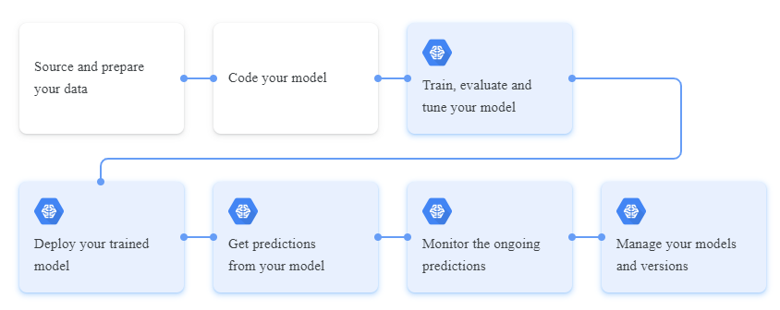
Machine Learning Workflow
Google, AI Platform

Slide 5
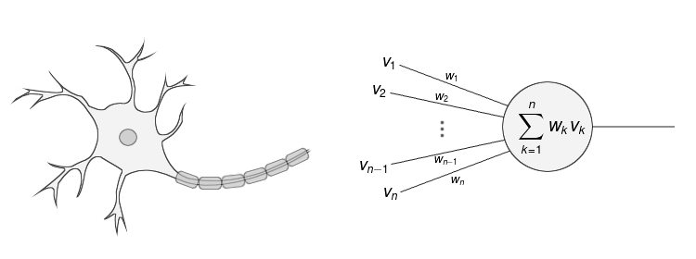
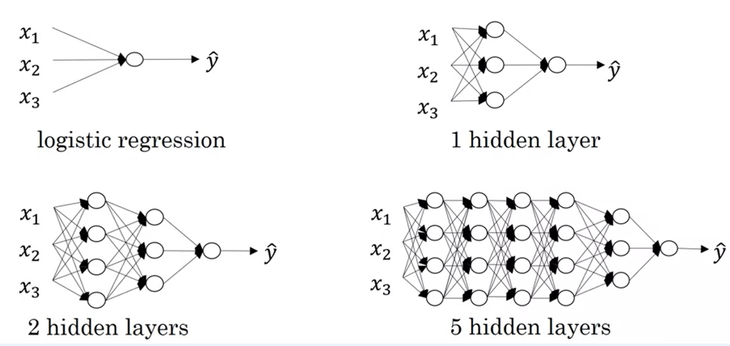
How does an ANN work ?
https://laptrinhx.com/
Deep Learning Specialization, Coursera, Andrew Ng

Slide 6
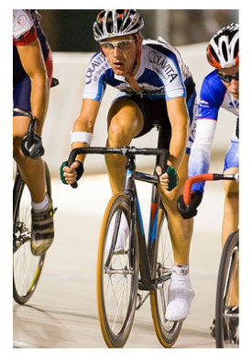
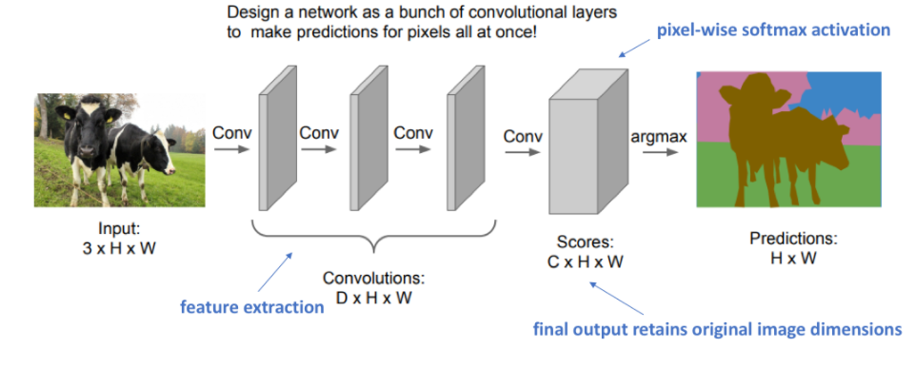
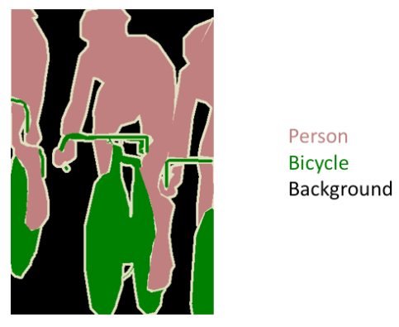
Introduction to Convolutional Neural Networks
Semantic Segmentation
http://host.robots.ox.ac.uk/pascal/VOC/voc2012/#devkit
http://cs231n.stanford.edu/slides/2017/cs231n_2017_lecture11.pdf

Slide 7
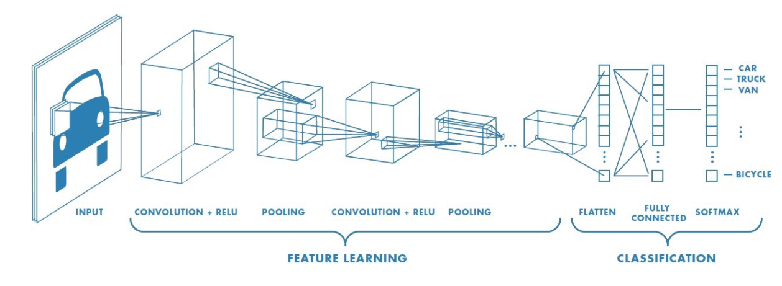
How does a CNN work ?
A Comprehensive Guide to Convolutional Neural Networks, towardsdatascience.com

Slide 8
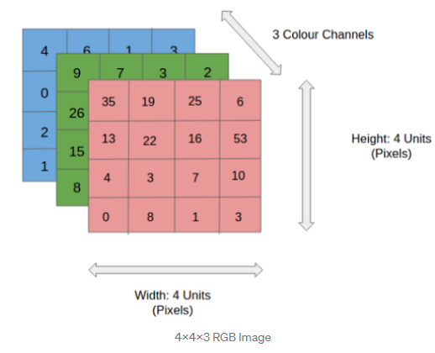

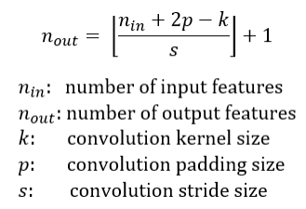
Convolutional Layer
A Comprehensive Guide to Convolutional Neural Networks, towardsdatascience.com

Slide 9
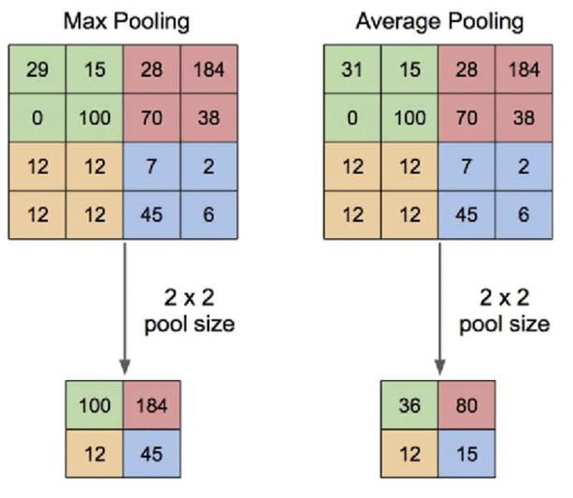

Pooling Layer
A Comprehensive Guide to Convolutional Neural Networks, towardsdatascience.com
Application of Transfer Learning Using Convolutional Neural Network Method for Early Detection of Terry’s Nail

Slide 10
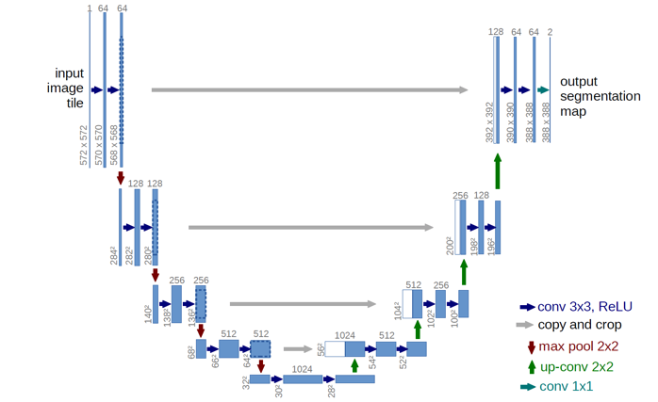
U-Net Architecture
U-net: Convolutional networks for biomedical image segmentation
O Ronneberger, P Fischer, T Brox - International Conference on Medical …, 2015 - Springer

Slide 11
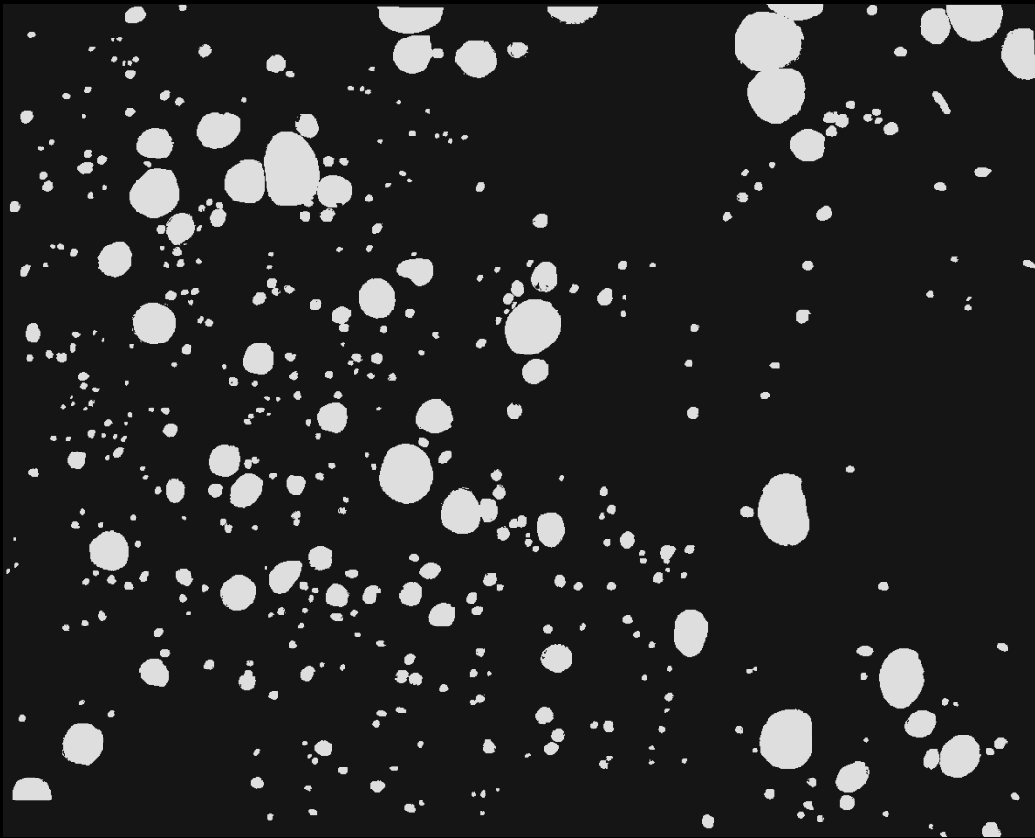
Input Image and Mask Image
RGB image of a liver section of shape (256,256,3)
Mask image as the grayscale ground truth (label)

Slide 12
Outline of Implementation
Libraries and Packages Used
Tensorflow
Scikit-Learn
Numpy
Matplotlib
Segmentation Models
PIL
Optuna
Outline
Define a custom pre-processing function
Generate batches of images and masks
Define a manual U-Net structure
Choose hyperparameters to be optimized
Define a loss function and validation metric (IoU score)
Compile and train the base model
Evaluate IoU score on test bench
Define the objective function to be optimized with Optuna, including the hyperparameters
Optimize for 10 trials
Evaluate IoU score on the best trial
Visualize results

Slide 13
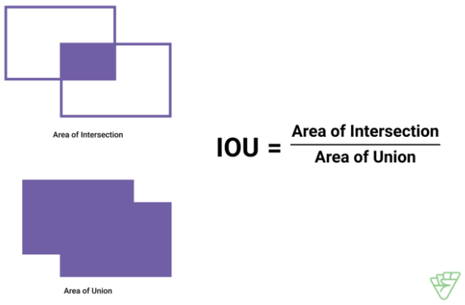
Training & Evaluation
Optimizer : Adam
Loss Function : Binary Focal Dice Loss
Metrics : IoU Score
https://medium.com/supahands-techblog/measuring-labelling-quality-with-iou-and-f1-score-1717e29e492f

Slide 14
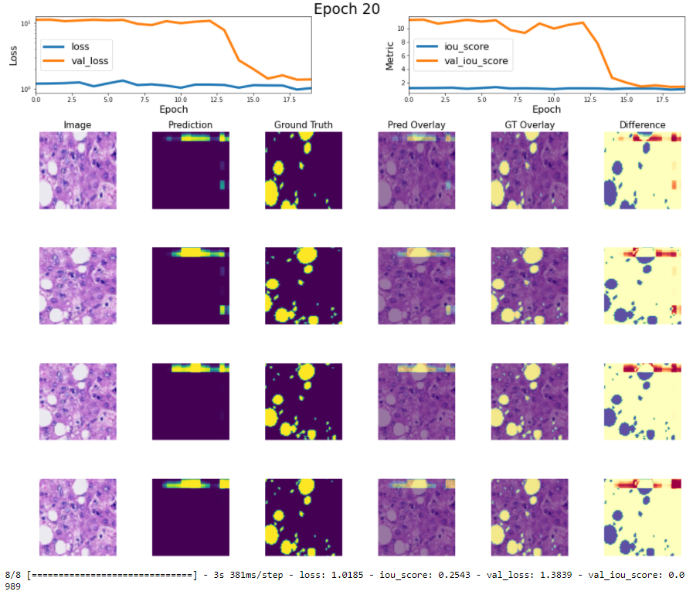
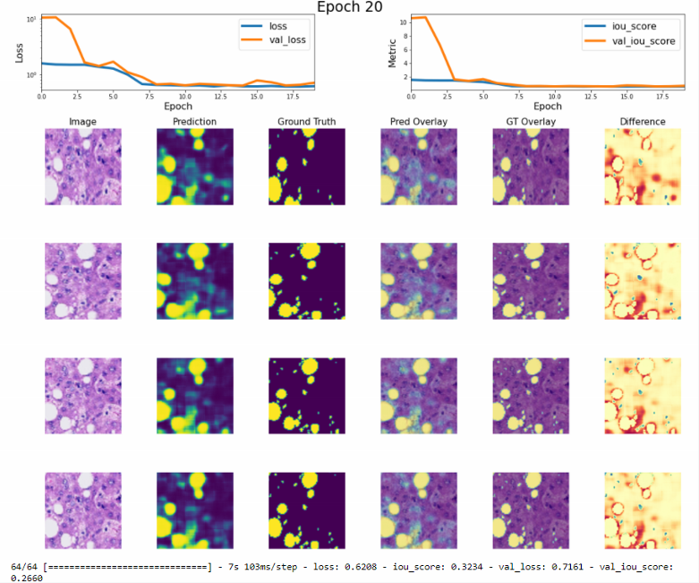
Trained Base Model
IoU Score : 0.105
IoU Score : 0.332

Slide 15
Importance of Hyperparameter Optimization
Hyperparameter :
A parameter that can be configured to tailor the algorithm to better fit the dataset.
Examples :
Learning rate
Number of filters
Filter size
Dilation, stride, padding
Activation
Dropout
Hyperparameter Tuning / Optimization :
testing a different set of values for some key parameters to see their individual effects, as well as which combination works best for the given problem.
Examples :
Grid Search
Random Search
Bayesian Search

Slide 16
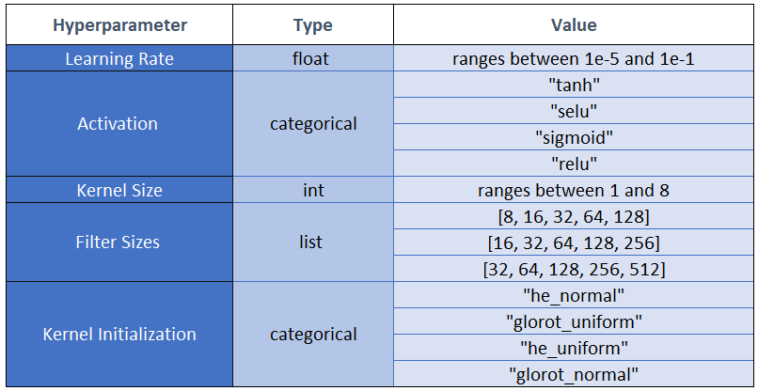
Set of Hyperparameters Chosen for Tuning

Slide 17
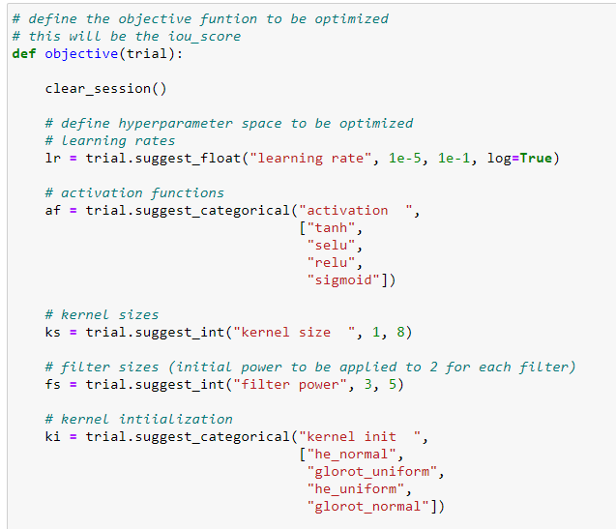
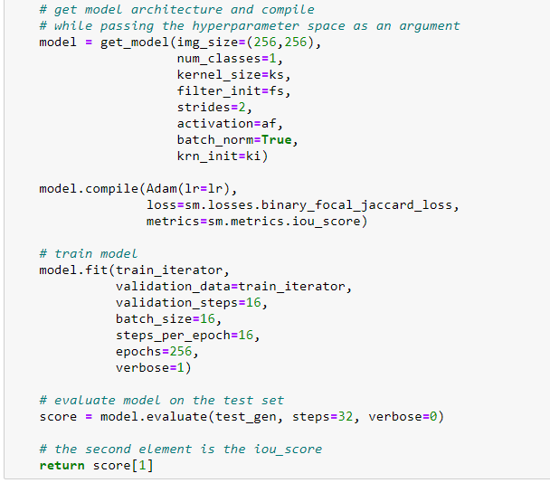
Implementation of Tuning in Optuna

Slide 18
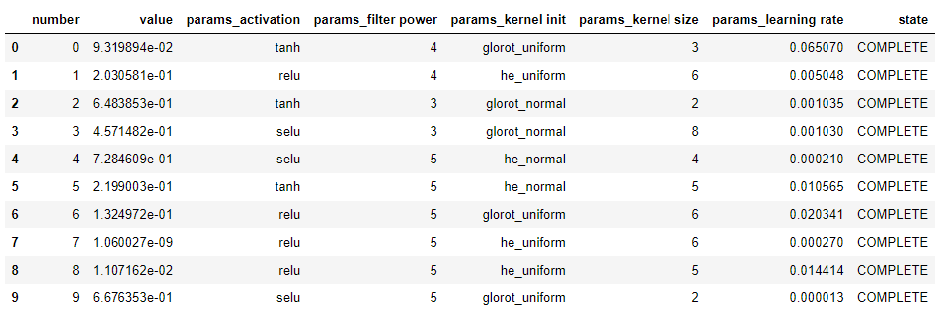
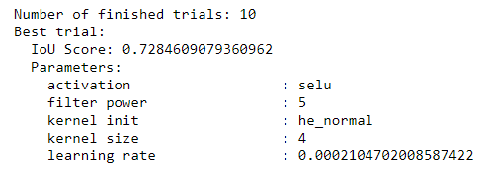
Results

Slide 19
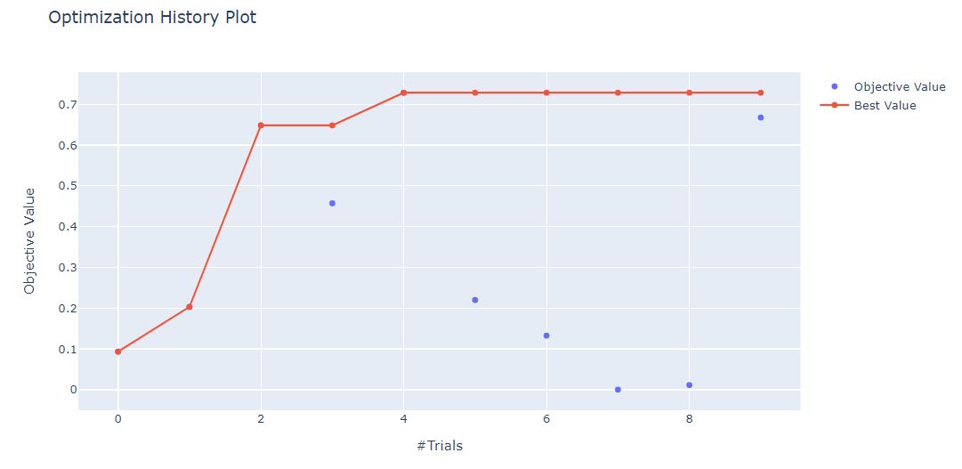
Results

Slide 20
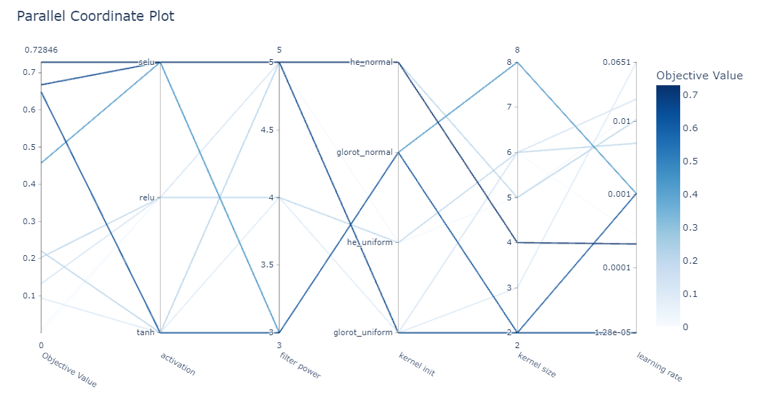
Results

Slide 21
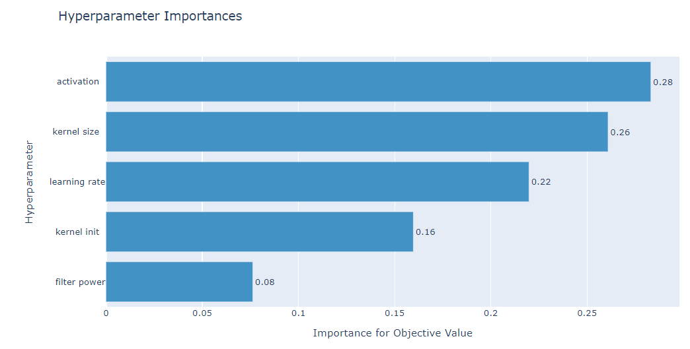
Results

Slide 22
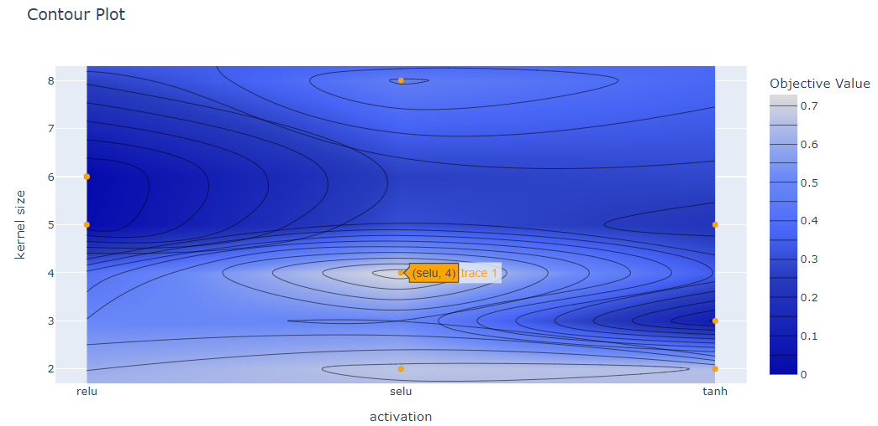
Results

Slide 23
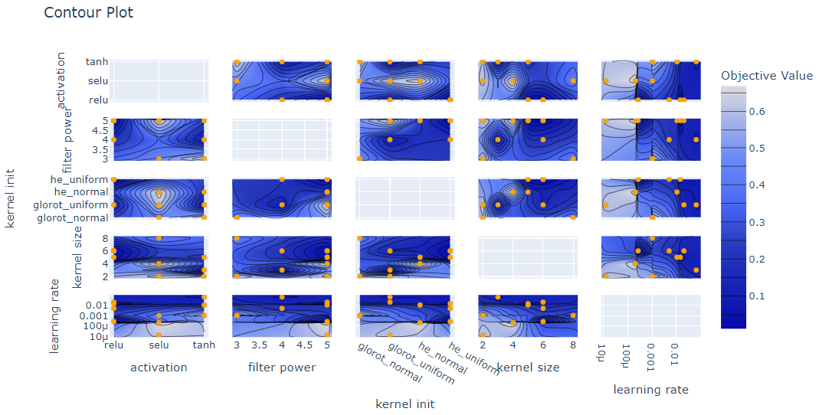
Results

Slide 24
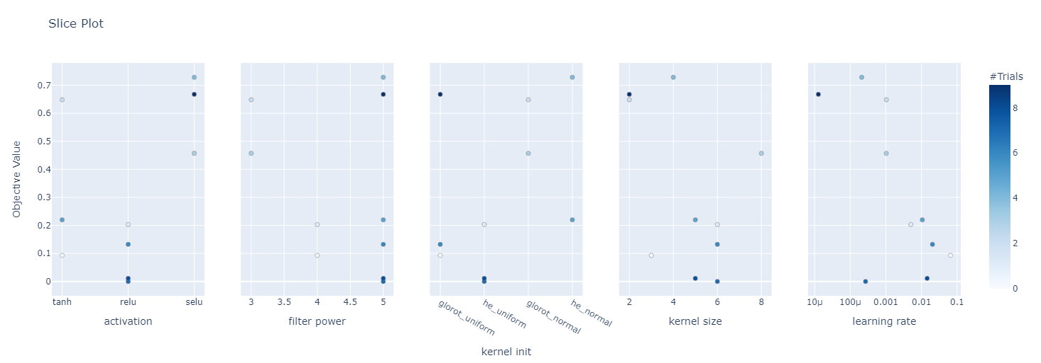
Results

Slide 25


Improved IoU scores on test set
Hyperparameter Optimization of a U-Net Trained for
Fat Detection in Liver Sections
Predict for further images and compare with true masks

Slide 26
References
U-net: Convolutional networks for biomedical image segmentation, O Ronneberger, P Fischer, T Brox, 2015, Springer
https://towardsdatascience.com/understanding-semantic-segmentation-with-unet-6be4f42d4b47
https://segmentation-models.readthedocs.io/en/latest/tutorial.html
https://keras.io/examples/vision/oxford_pets_image_segmentation/
https://optuna.readthedocs.io/en/stable/indexhttps://optuna.readthedocs.io/en/stable/index.html.html

Slide 27
Thank you for your attention.

